Slide 1
Newborn Feeding and Weight loss
By Jessie Marks DNP, ARNP

Slide 2
Learning Objectives
Know how to evaluate growth and feeding during early infancy
1
Identify infants at risk for feeding difficulties related to ankyloglossia and understand the management benefits and risks.
5
Understand the appropriate management for excessive weight loss.
4
Understand different types of formulas and when to use
3
Be able to monitor for adequate breastfeeding
2

Slide 3
Newborn feeding pattern
Breastfeeding
Newborns should be breastfeeding about 8-12 times in 24 hours
Every 2-3 hours
For about 15-20 minutes (length may vary)
Concerning if taking longer than 30 minutes to nurse
Formula
6-8 times in 24 hours
Every 3-4 hours
By 1 month of life, infant should be taking 4 oz every 4 hours
Notes:
https://www.uptodate.com/contents/poor-weight-gain-in-children-younger-than-two-years-management?search=slow%20weight%20gain%20infant&source=search_result&selectedTitle=3~150&usage_type=default&display_rank=3

Slide 4
Newborn Intake/Output Norms
Day | Age | Milk Volume per Feed (ml) | Number of feeds | Number of voids | Number of stools
1 | 0-24 hours | 0-5 | >6 | ≥1 | ≥1
2 | 24-48 hours | 5-10 | ≥8 | 2-3 | 1-2
3 | 48-72 hours | 10-20 | ≥8 | 4-6 | ≥3
4 | 72-96 hours | 20-30 | ≥8 | 4-6 | ≥4
5 | >96 hours | >30 | ≥8 | 6-8 | ≥4
American Academy of Pediatrics Textbook of Pediatric Care, edited by Thomas K. McInerny, et al., American Academy of Pediatrics, 2016. ProQuest Ebook Central, http://ebookcentral.proquest.com/lib/washington/detail.action?docID=4612328. Created from washington on 2019-01-04 10:58:02.
Notes:
Reference common problems in newborn nursery page 121

Slide 5
Weight Loss
Weight loss after birth is expected, about 5-7% of birth weight
Normal infants stop losing weight after 5 days and start to regain weight
Should regain birth weight by 10-14 days of life
For vaginal delivery- average weight loss 4.2% at 24 hours, 7.1% at 48 hours and 6.4% at 72 hours.
For c-section delivery- average weight loss 4.9% at 24 hours, 8% at 48 hours, 8.6% at 72 hours and 5.8% at 96 hours.

Slide 6
Early Postnatal Growth
 | Usual pattern | Trigger for action
Weight loss | 5 to <7 percent | >7 percent
Duration of weight loss | <5 days | 5 to 10 days
Time to regain birthweight | One to two weeks | >2 weeks
Intervention | Routine management | Evaluate lactation management
 |  | Rule out primary lactation failure
 |  | Rule out infant oral-motor abnormalities
 |  | Monitor closely, including daily weights
 |  | Consider supplementation

Slide 7
Calculate weight loss percentage
Subtract the current weight from the birth weight
Divide the weight loss number by the birth weight and multiply it by 100 to get a percentage.
Example: Birth weight 3200g and current weight is 3080g
Step 1: 3200g-3080g= 120g
Step 2: 120g/3200g = 0.0375
Step 3: 0.0375 x100= 3.75%
Online tool at www.newbornweight.org.

Slide 8
Calculate Daily weight gain
Age | Expected weight gain (g/day)
0-3 months | 26-31
3-6 months | 17-18
6-9 months | 12-13
9-12 months | 9
1-3 years | 7-9
©2015 UpToDate®
Expected daily weight gain for children younger than three years
Data from: Frank DA. Failure to thrive. In: The Zuckerman Parker Handbook of Developmental and Behavioral Pediatrics for Primary Care, 3rd ed, Augustyn M, Zuckerman B, Caronna EB (Eds), Lippincott Williams & Wilkins, Philadelphia 2011. p.204.
Take today's weight - prior measurement = change in kg.
THEN take that change divided by number of days between measurements = daily average in kg.
Remember .020kg = 20g

Slide 9
Excessive weight loss
> 10% of birth weight
At 48 hours of life about 5% of vaginal births and 10% of c-section births had > 10% weight loss
Excessive weight loss may be associated with increased risk for hyperbilirubinemia and hypernatremic dehydration

Slide 10
Excessive weight loss management
Detailed feeding and output history
Physical exam, assess for hypovolemia and hyperbilirubinemia
Examination of mother's breast
Observe feeding
Infant position
Latch
Maternal milk supply
Adequate or inadequate milk transfer
Breastfeeding with close observation vs supplementation
If infant is well appearing, with an increase in maternal milk production and infant's weight in the past 24-48 hours, observation only may be appropriate
If no improvement in milk production or infant weight gain than formula supplementation may be required
With severe weight loss, IV fluids may be needed to correct hypernatremia and hypovolemia
Notes:
If continuing to have weight loss despite formula supplementation, hospital admission may be necessary for IV fluid management. If persistent slow weight gain occurs past the first few weeks of life, the diagnosis of failure to thrive may need to be considered and further referrals may be warranted such as OT, Endocrine.

Slide 11
Formula
Types
Cow milk protein-based formulas: the cow's milk has been altered to resemble breast milk, makes the formula easier to digest.
Soy-based formulas: Can help infants who are intolerant or allergic to animal proteins or lactose. However, infants who are allergic to cow's milk might also be allergic to soy milk.
Protein hydrolysate formulas- the protein has been broken down or hydrolyzed either partially or more extensively than cow's milk or soy-based formulas. These formulas are meant for infants who do not tolerate the previous types of formula.
Further specialized formulas: for premature infants and those with certain medical conditions (use a dietician if needing to use these)
Calories:
20 cal, 22 cal and 24 cal
Notes:
Some infant's can be allergic to proteins in cow's milk and may need another type of formula

Slide 12
Caloric Need
For excessive weight loss or slow to gain weight, if formula supplementation is warranted the following needs to be considered:
Type of formula
Overall caloric need
Volume intake (some infants cannot take the oral volume needed to meet caloric demand, so higher calorie formula is given, and feed volume is decreased)
Preterm infants – Goal is 120 kcal/kg per day
If infant is taking 24 kcal/oz formula this would equal 150 to 160 mL/kg per day
Term infants –110 kcal/kg/day at 1 month of age, 95 kcal/kg/day at 3 months of age
Sarah, F. E., MD, & Christopher, D., MD. (n.d.). Overview of enteral nutrition in infants and children. Retrieved March 24, 2021, from https://www-uptodate-com.offcampus.lib.washington.edu/contents/overview-of-enteral-nutrition-in-infants-and-children/print?search=poor weight gain infant&topicRef=2874&source=see_link

Slide 13
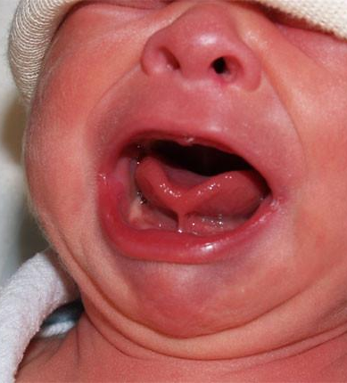
Feeding concern
A 10-day old infant is brought to the office for feeding concern. Mother states she is having a lot of nipple pain when breastfeeding and mother hears "clicking" noises during feeds. Furthermore, she was told by the lactation RN that her infant is "tongue-tied".
On exam you noticed a lingual frenulum that is tight and is limiting the infant's forward and upward movement of the tongue. You agree with the assessment of the lactation RN that the infant has ankyloglossia.
What are your next steps for management?

Slide 14
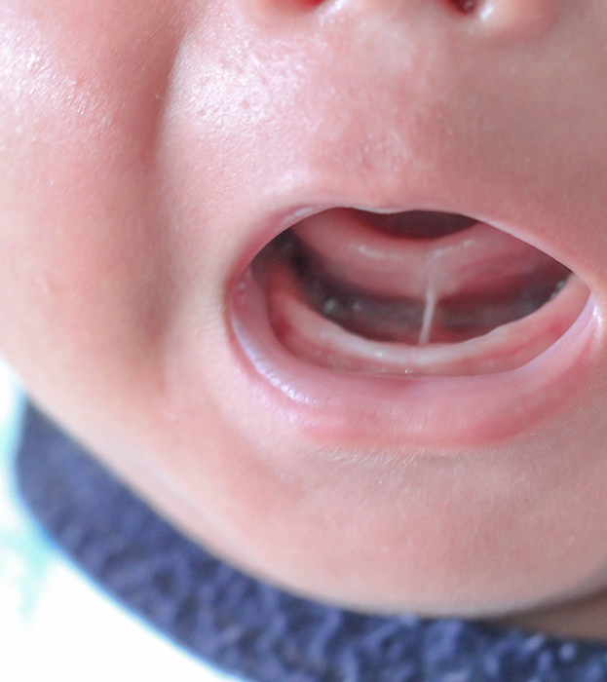
Ankyloglossia
Clinical Features
●Abnormally short frenulum, inserting at or near the tip of the tongue
●Difficulty lifting the tongue to the upper dental alveolus
●Inability to protrude the tongue more than 1 to 2 mm past the lower central incisors
●Impaired side to side movement of the tongue.
●Notched or heart shape of the tongue when it is protruded
● Frenulum that prevents placement of the examiner's fingers between the underside of the tongue and mandibular alveolus is considered abnormally restrictive

Slide 15
Possible Sequelae
●Newborn or young infant with breastfeeding difficulty
●Toddler or young child with articulation problems
●Older child or adolescent with mechanical difficulties and/or social embarrassment due to restricted tongue movement (inability to lick lips, kissing)

Slide 16
Ankyloglossia Management
Lactation consultant evaluation and support
If continued difficulty breastfeeding despite lactation support, then frenotomy is suggested.
Frenotomy needs to be done by trained provider (pediatric primary care, ENT, pediatric dentist).
Frenotomy has modest efficacy in improving breastfeeding outcomes, however, quality of evidence is low.
If an infant needs a frenuloplasty, release of frenulum with plastic repair, this requires general anesthesia and needs to be done by ENT provider.

Slide 17
References
American Academy of Pediatrics Textbook of Pediatric Care, edited by Thomas K. McInerny, et al., American Academy of Pediatrics, 2016. ProQuest Ebook Central, http://ebookcentral.proquest.com/lib/washington/detail.action?docID=4612328. Created from washington on 2019-01-04 10:58:02.
Infant Formula: Your Questions Answered, Access January 17, 2019. https://www.mayoclinic.org/healthy-lifestyle/infant-and-toddler-health/in-depth/infant-formula/art-20045782
Sarah, F. E., MD, & Christopher, D., MD. (n.d.). Overview of enteral nutrition in infants and children. Retrieved March 24, 2021, from https://www-uptodate-com.offcampus.lib.washington.edu/contents/overview-of-enteral-nutrition-in-infants-and-children/print?search=poor weight gain infant&topicRef=2874&source=see_link
Poor weight gain in children younger than two years management. Retreived on January 17, 2019 from https://www.uptodate.com/contents/poor-weight-gain-in-children-younger-than-two-years-management?search=slow%20weight%20gain%20infant&source=search_result&selectedTitle=3~150&usage_type=default&display_rank=3
Ankyloglossia retreived on January 17, 2019 from https://www-uptodate-com.offcampus.lib.washington.edu/contents/ankyloglossia-tongue-tie-in-infants-and-children?topicRef=6282&source=see_link#H1001316250

